Slide 1

Notes:
Start

Slide 2
?
Notes:
What is Android Wear?
Android Wear is a set of APIs that extends the Android platform to a new generation of wearables.
Rich notifications can appear on the wearable with no modification to the existing Android app.
The developer can add just a few more lines of code to extend the wearable experience or go even deeper by building an app just for the wearable.
Before we dive into the details of the platform, let’s take a step back.

Slide 3

#androidwear
Notes:
What’s wrong with this picture?
Google’s been spending some some time looking at technology usage, and thinking deeply about ways of staying connected to the people around you, and those not currently with you.
I don't need to tell you how useful a phone or a tablet is to our everyday life and there are certainly great use-cases for that.

Slide 4
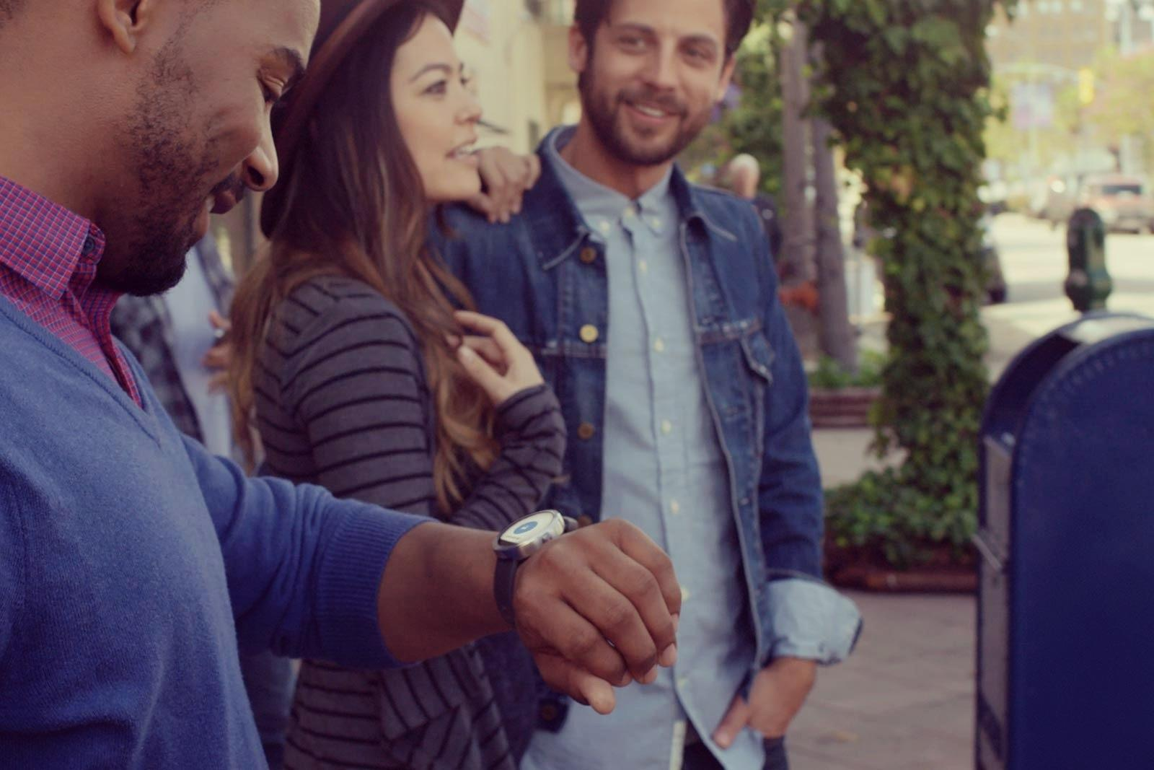
#androidwear
Notes:
Android Wear aims to complete that picture
by helping you stay in the moment when it's appropriate
Give you useful information the moment you need it, and in just a glance.
Let’s look at that in a more technical way

Slide 5
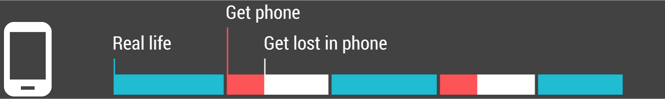
#androidwear
Notes:
This is your day with your phone
Notice the length of time it takes to pull out your phone out of your pocket, unlock it, navigate to what you want, and then engage with it
There are certainly times that you want to get lost in your phone - commuting on a train or waiting in line somewhere.
However, there's hefty time and attention cost if you only want to feel connected when you are out and about especially when you are with other people

Slide 6
#androidwear
Notes:
This is the same set of interactions on a wearable, but notice the reduced overhead per interaction
This is what is meant by “More present in the real world, and yet, more connected to the virtual world”
Now what does that mean for your development?
Well, to start with (and this is important), it’s a fundamentally different User Interaction model

Slide 7
Technology
Should not require all our attention
Require least amount of cognitive overhead
Provide information without distraction
Compress information
#principles_calmtechnology
Notes:
Android Wear Style Guidelines

Slide 8
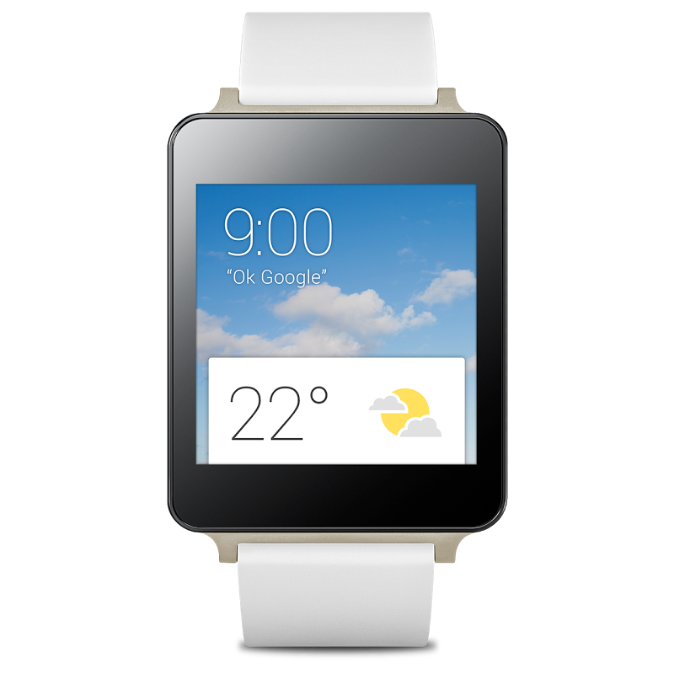
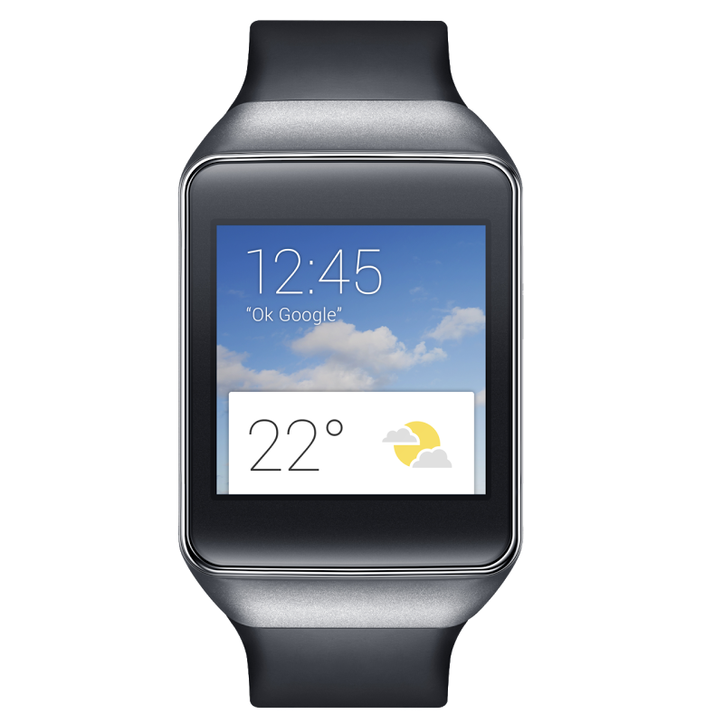
#androidwear
Notes:
And you can tell, just by looking at this device. It’s fundamentally different than other mobile devices.
To really nail the user experience you gotta re-think it a little…
When considering which features of your service you'd like to make available on the wrist, consider this question:"What couldn't we do on the phone, that we can now do on the wrist? What now becomes possible?"
Then focus on that.
Also, you gotta try it.

Slide 9
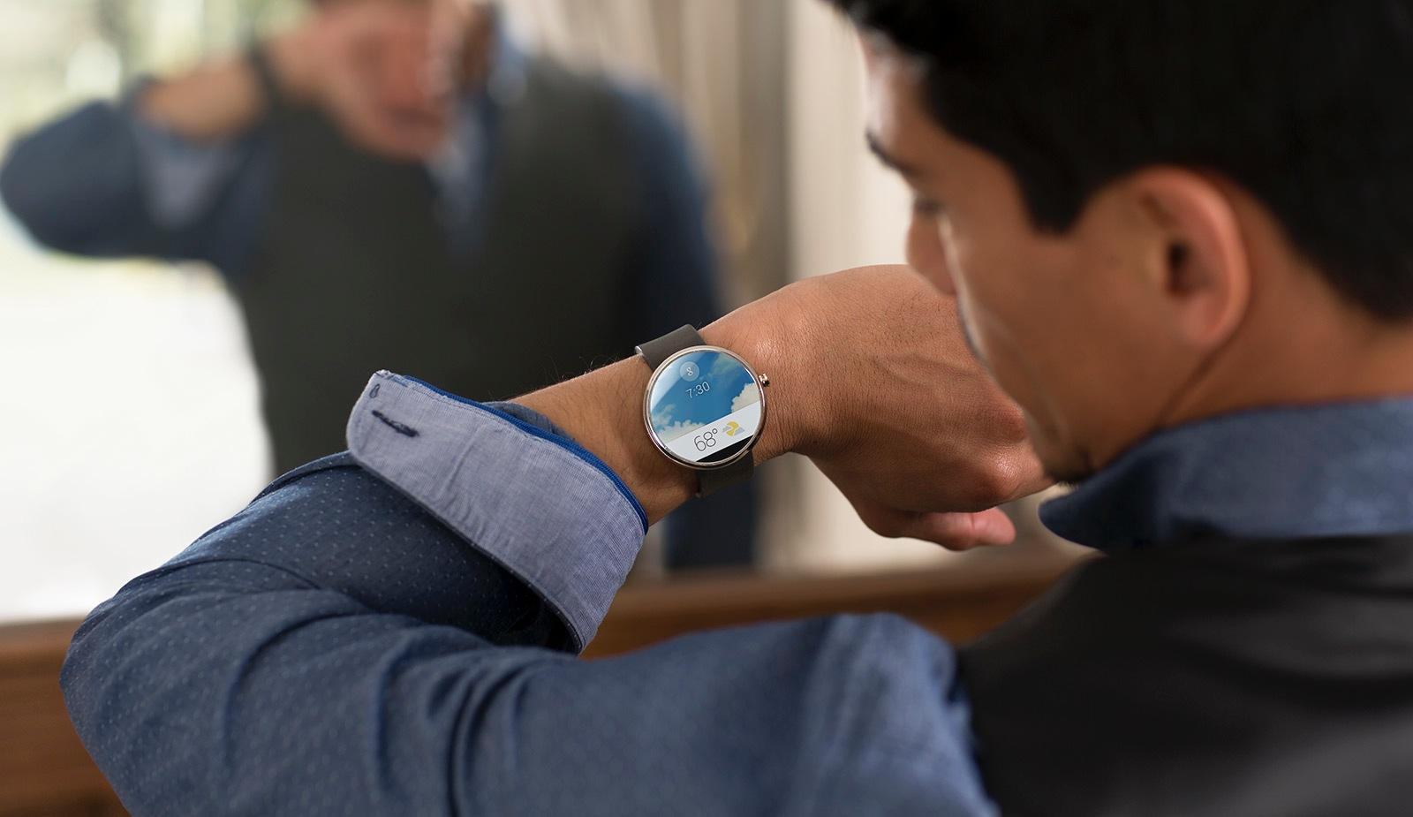
#androidwear
Notes:
It may sound silly, but try putting the watch on and standing up when you test it out. Get yourself in the situation, so you know what it feels like to use the service on the go.
Here’s an example of a very basic but essential difference

Slide 10
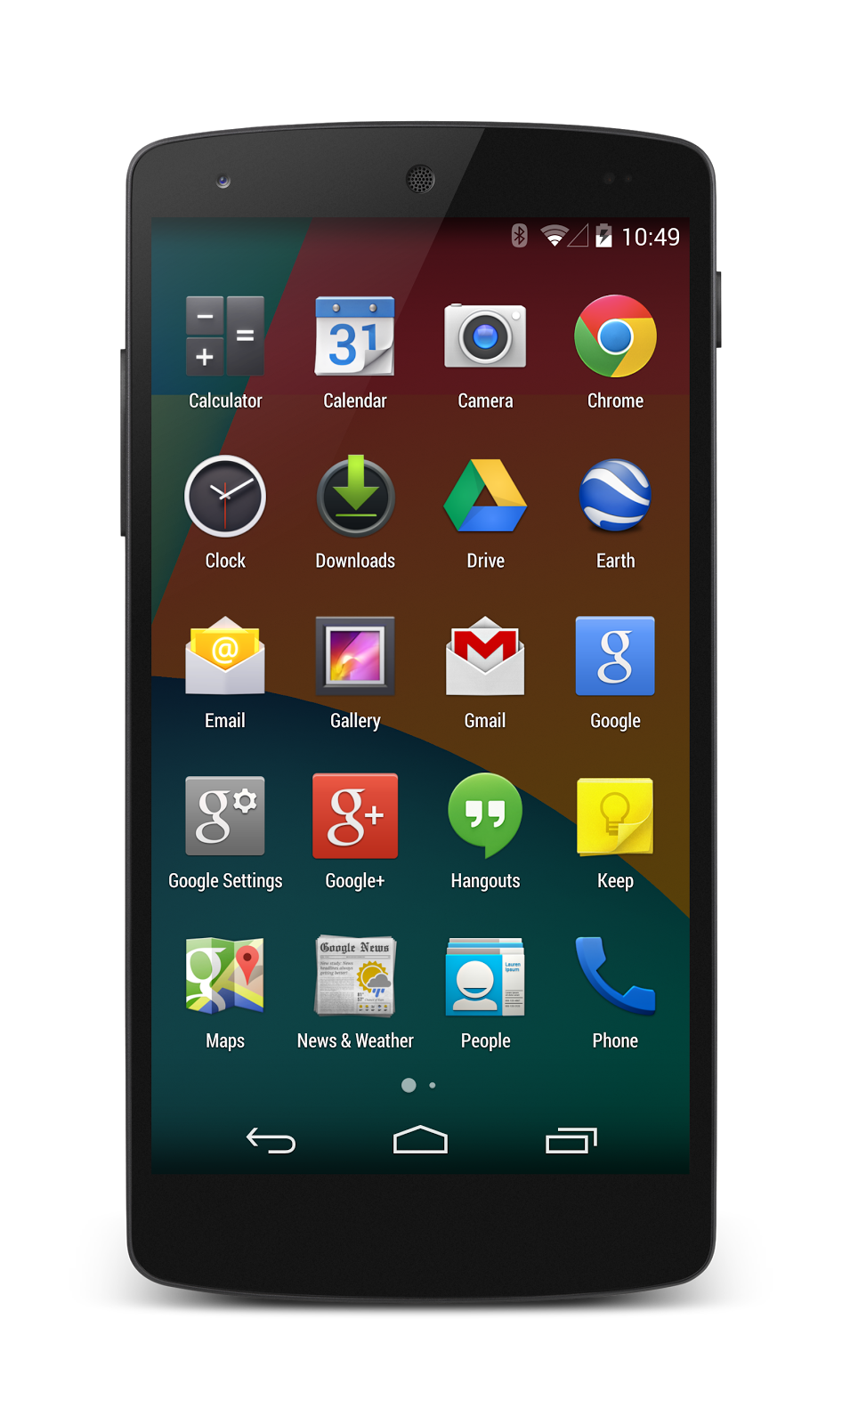
#androidwear
Notes:
This is the app experience on your phone
We’ve trained users to collect these shiny objects and then search for them when they want to do something. Which works fine on a phone.
But if we…

Slide 11
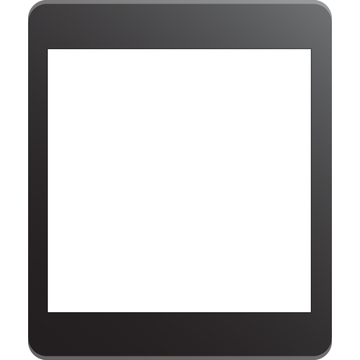
#androidwear
Notes:
…just put those same shiny objects on the wearable
But then it’d be the same time consuming paradigm, but on a device intended to reduce those parts of the interaction. It just doesn’t make sense.
How do we get outside of this paradigm?
How do we get past of this grid of icons?

Slide 12
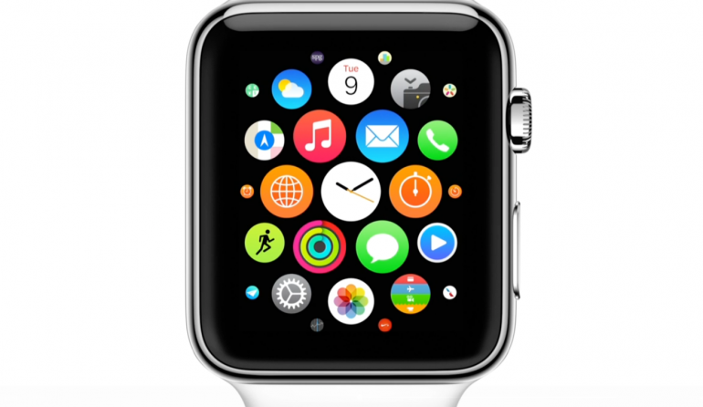
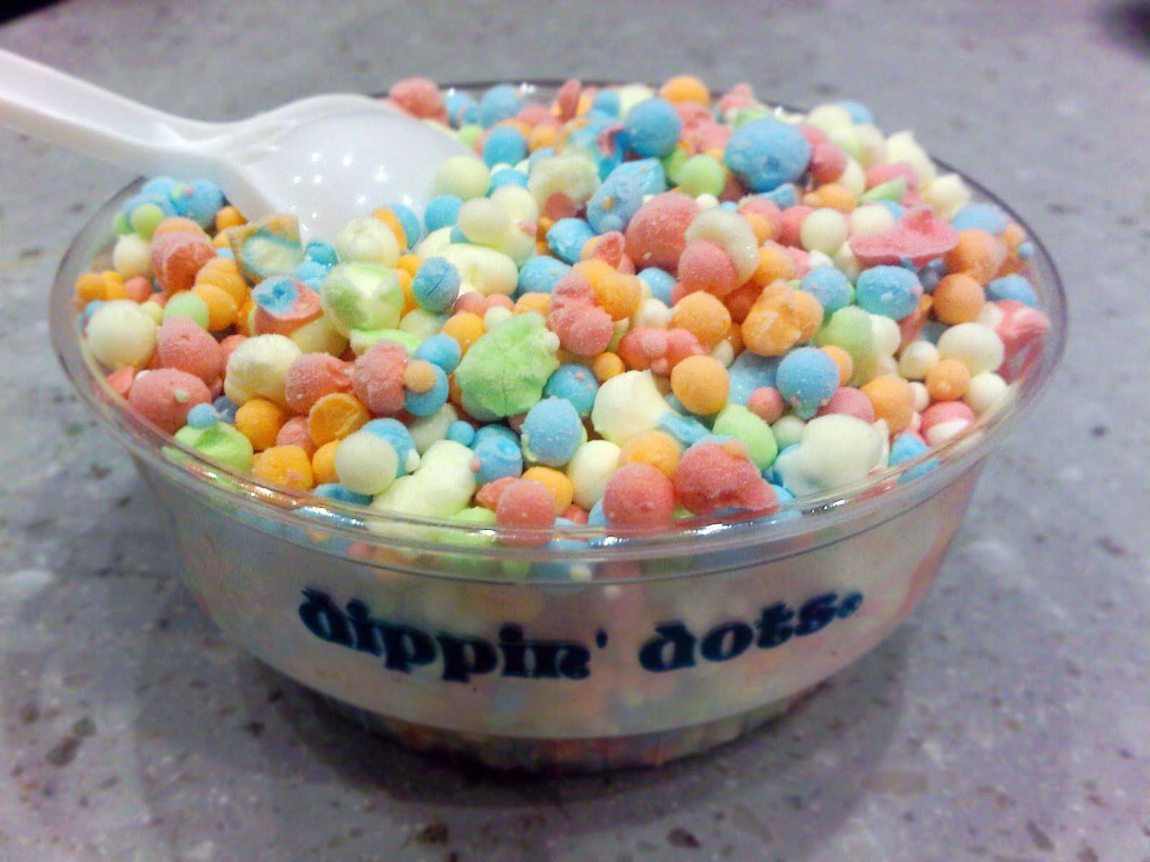
Notes:
But it could be even worse.
How do we get outside of this paradigm?
How do we get past of this grid or pile of icons? [click]

Slide 13
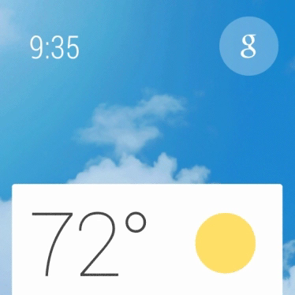
#androidwear
Notes:
[pause]
This is the Android Wear interface
Simple, glanceable, and built around micro-interactions
The interface is divided into two primary behaviors

Slide 14
you talk to the wearable
#androidwear
Notes:
The user can talk to the wearable

Slide 15
actions
#androidwear
Notes:
You can think of these actions

Slide 16
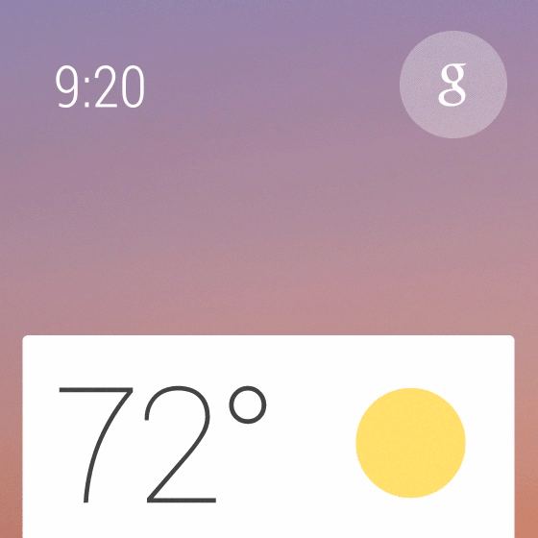
actions
#androidwear
Notes:
The user can say “Ok Google” and then any voice command available to them

Slide 17
actions
the wearable talks to you
#androidwear
Notes:
The wearable can talk to the user

Slide 18
actions
context
#androidwear
Notes:
Think of this as a context stream

Slide 19
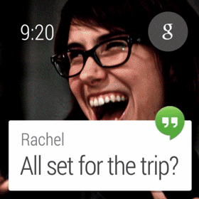
actions
context
#androidwear
Notes:
You can think of it like enhanced notifications that matter to the user right now because it’s the right time or place.
That’s the basic framework, and it sets you up for success…

Slide 20
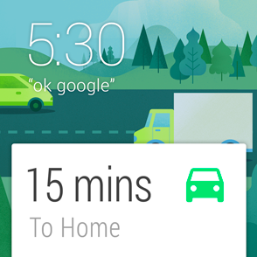
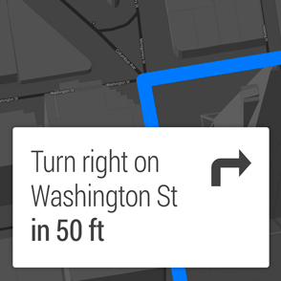
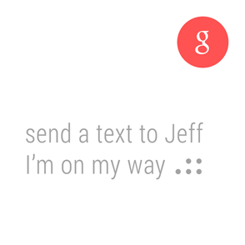
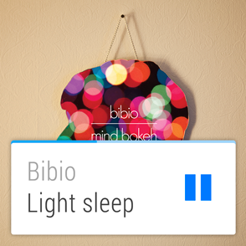
#androidwear
Notes:
But to really make it all the way there, you need to carry this philosophy into your application as well.
By providing a smart connection to the rest of the world while respecting the user’s attention, Android Wear feels personal and global, simple and smart, unobtrusive and ever-ready.
Applications that represent the following principles will feel most at home in the overall Android Wear experience.

Slide 21
Launched automatically
#androidwear
Notes:
Wearable apps are aware of the user’s context - time, location, physical activity…
The apps use this information to insert cards into the stream when they become relevant.
This makes Android Wear timely, relevant and very specific.

Slide 22
Glanceable
#androidwear
Notes:
A classic wrist watch is designed to let you see the time in a split second and get on with what you were doing. It should be the same for Android Wear.
The less time it takes to use your software, the more time the user can be present in whatever they are doing.
Android wear is fast, sharp and immediate.

Slide 23
Suggest and demand
#androidwear
Notes:
Remember what we looked at just a moment ago, the wearable can talk to the user and the user can ask things of the wearable
You can visualize this much like a personal assistant: it knows you and your preferences, it only interrupts you when absolutely necessary, and it’s always on hand to provide a ready answer.
Android Wear is helpful, respectful, and responsive.

Slide 24
Zero or low interaction
#androidwear
Notes:
Android Wear focuses on simple interactions, only requiring input by the user when absolutely necessary.
Most inputs are based around touch swipes or voice, and inputs requiring fine-grained finger movements are avoided.
Android Wear is gestural, simple, and fast.

Slide 25
#androidwear
Notes:
Keep these in mind as you dream up your Android Wear experience
As with everything here, please also check out the additional detail in our documentation

Slide 26
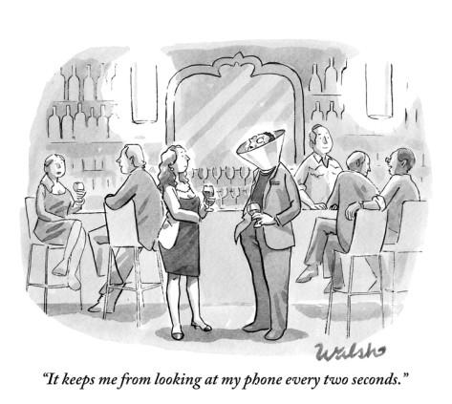
Notes:
Because otherwise, we get the same, poor, user experience we had before… only with a smaller screen on our wrists.
Wear seeks to change that. To make it so we spend no more than we need to, and spend the rest enjoying our lives.
If you’re still not convinced, think about this - when you look at a normal wristwatch, how long do you spend looking at it?

Slide 27
Developing
Notes:
Let’s take a break and think about how the design is different… and then talk about developing for Wear.
Okay, let’s talk about developing with Android Wear

Slide 28
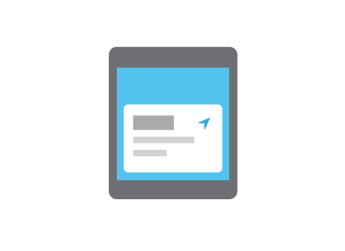
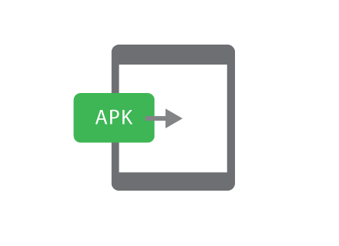
Notifications
Apps
#androidwear
Notes:
Bridged notifications
Apps

Slide 29
Notifications
#androidwear
Notes:
First: Notifications

Slide 30
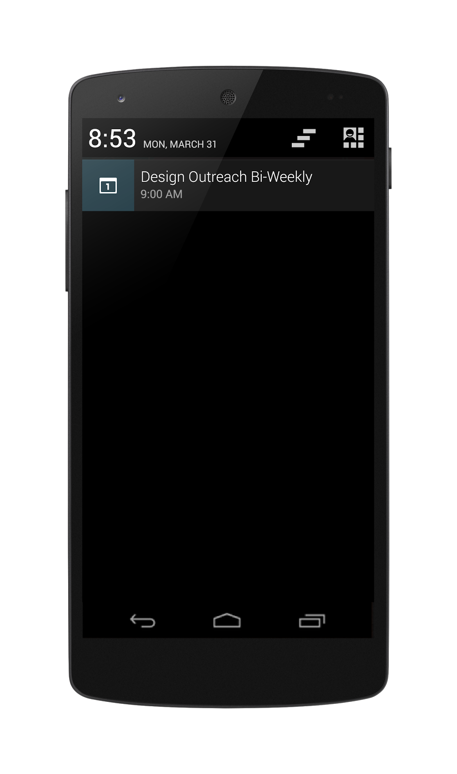
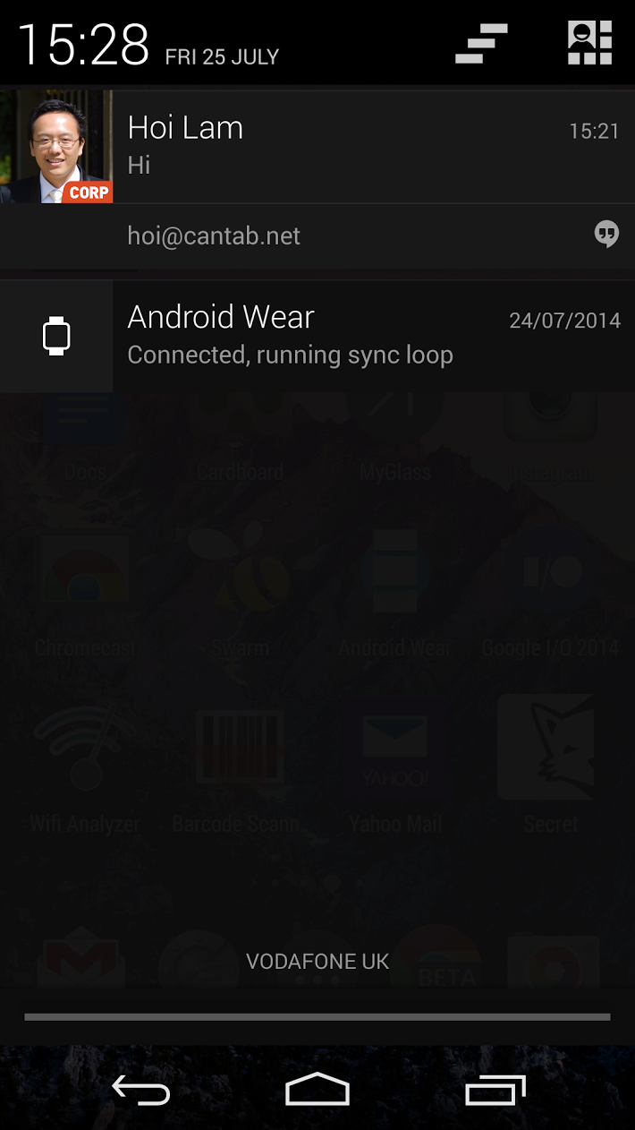
#androidwear
Notes:
The notifications on your phone can also be displayed…

Slide 31
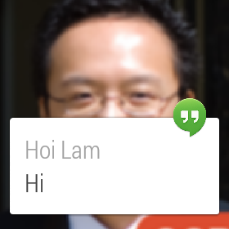
#androidwear
Notes:
… on the wearable
And to get this done…

Slide 32
NO WORK REQUIRED
#androidwear
Notes:
…you don’t have to do anything
It already works out of the box.
Also, notifications that buzz or sound on the companion device, will also buzz on the wearable

Slide 33
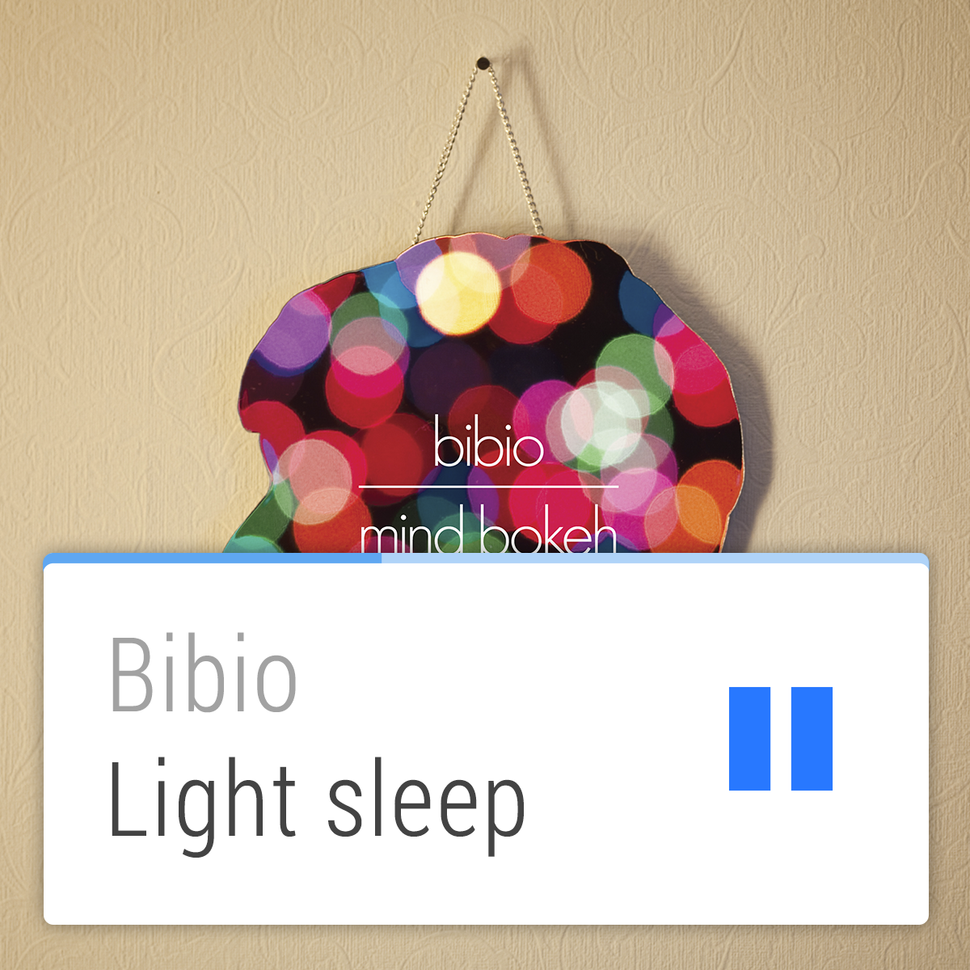
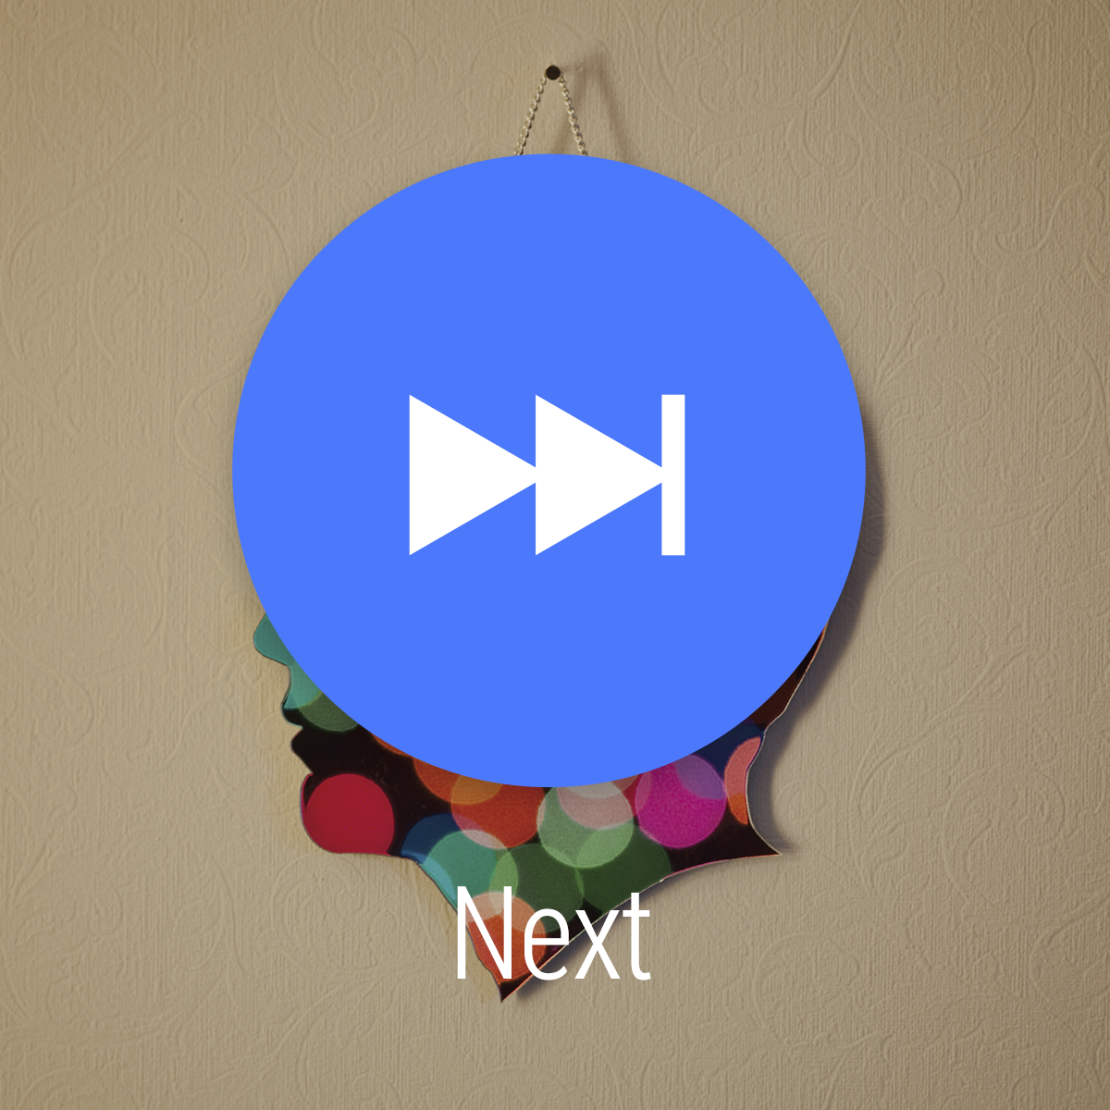
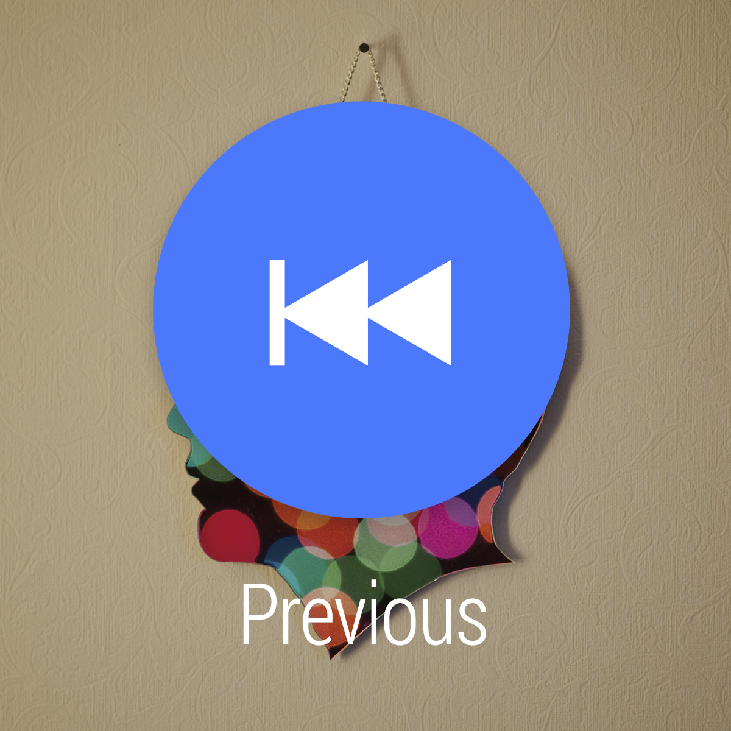
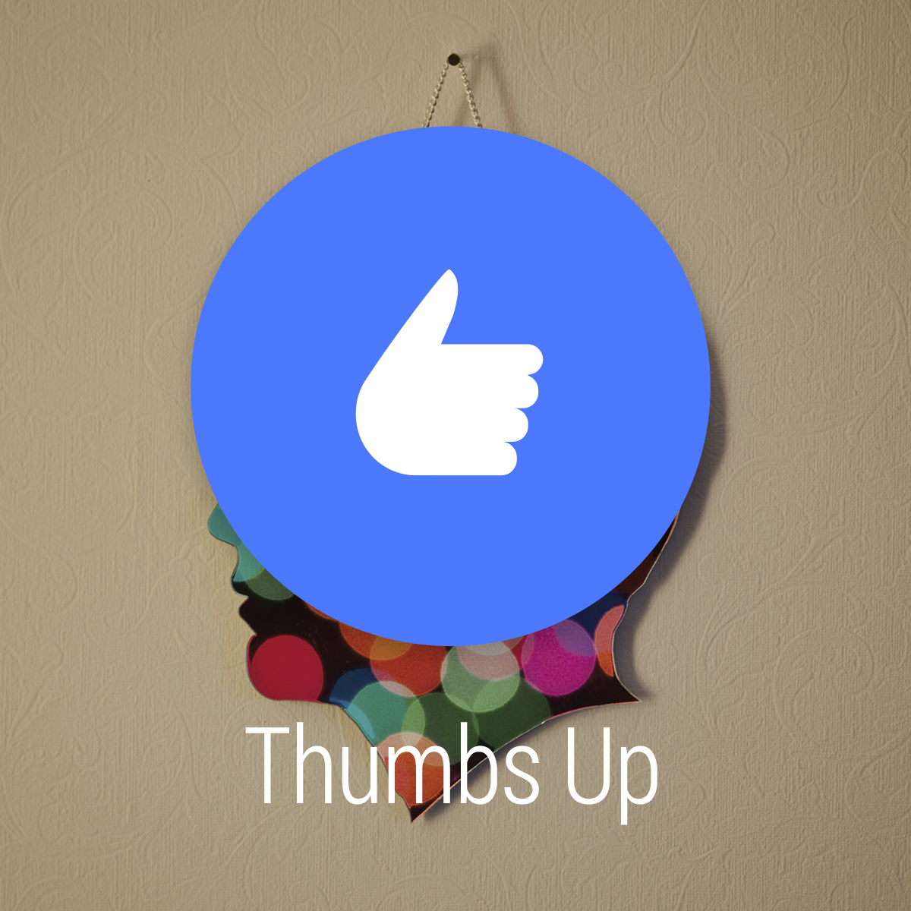
#androidwear
Notes:
Enhanced notifications will also show up on the wearable
If you implement lock screen control using RemoteControlClient, Android Wear will automatically support this.
And to get this done…

Slide 34
NO WORK REQUIRED
#androidwear
Notes:
…you still don’t have to do anything
It also already works out of the box.

Slide 35
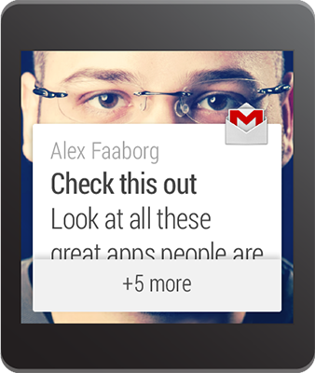
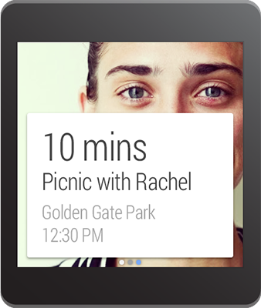
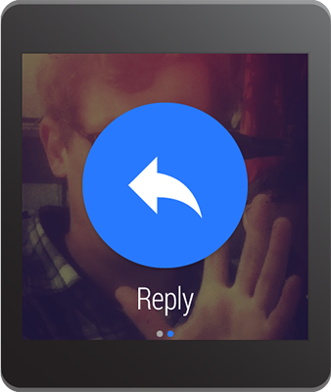
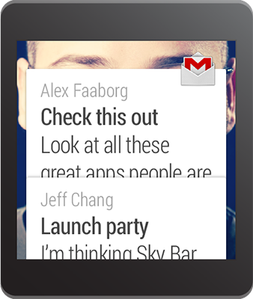
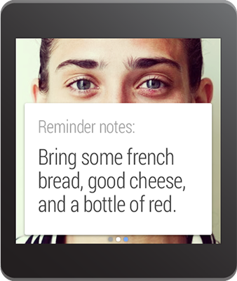
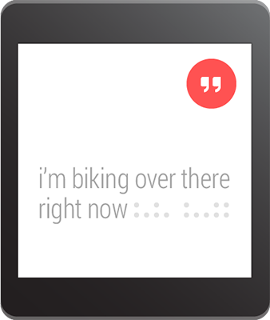
Stacks
Pages
Replies
#androidwear
Notes:
There are three more features you can easily take advantage of by adding a few more lines of code to your Android app
Stacks are like inbox-style notifications. You can deliver multiple items in a single bundle
Pages are for showing multiple screens of information on the same topic, but remember to stay glance able.
Replies allow the user to reply directly from the wearable via voice

Slide 36
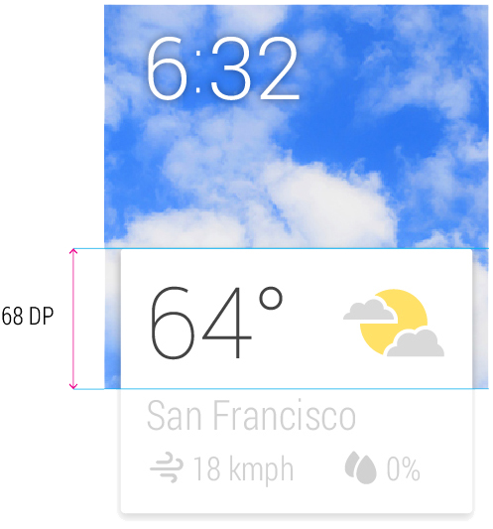
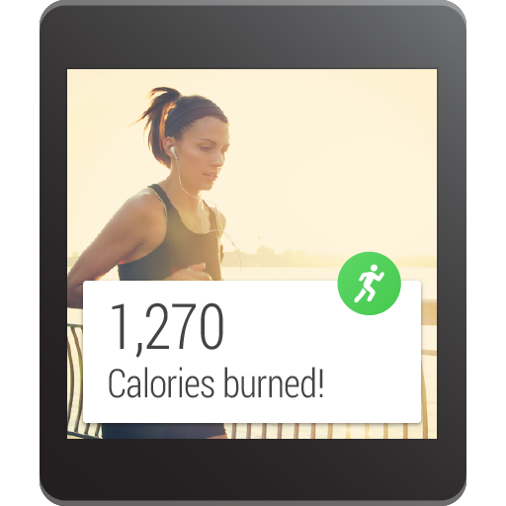
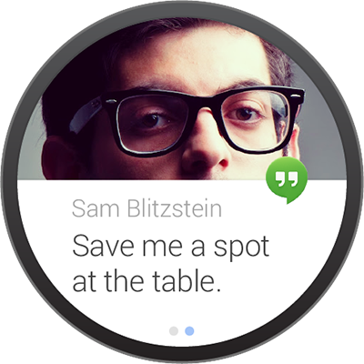
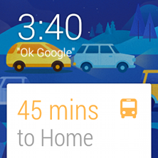
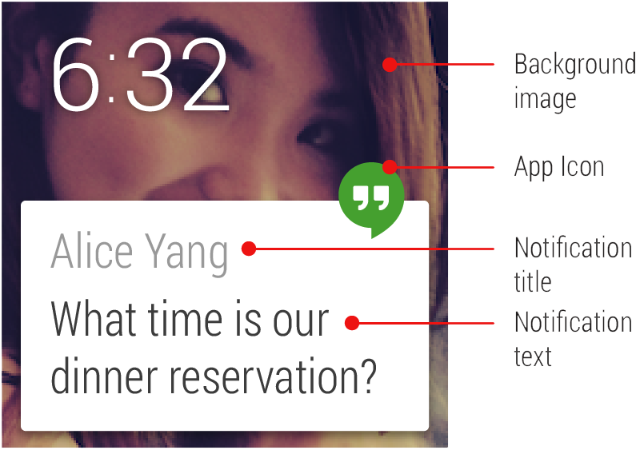
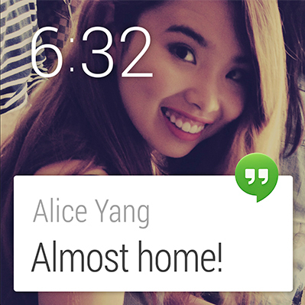
Android Wear Style Elements
Peek Card Readability
Square v/s Round
Low Information Density
Use Clear, Bold Typography
Additional Assets
#androidwear
Notes:
Android Wear Style Guidelines

Slide 37
Notifications
#androidwear
Notes:
Okay, that was notifications

Slide 38
Apps
#androidwear
Notes:
Now let’s talk about apps

Slide 39
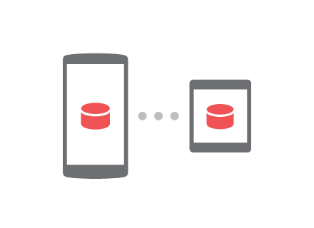
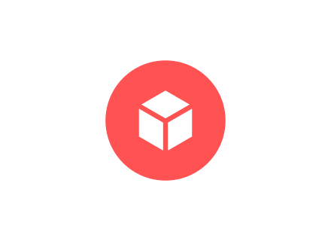
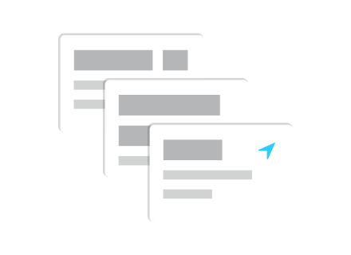
Send data
Custom UI
Voice Actions
#androidwear
Notes:
Sharing data between the phone and the wearable
Custom UI options
How to integrate voice

Slide 40
Establish Connection
#androidwear
Notes:
The first step is to establish the connection

Slide 41
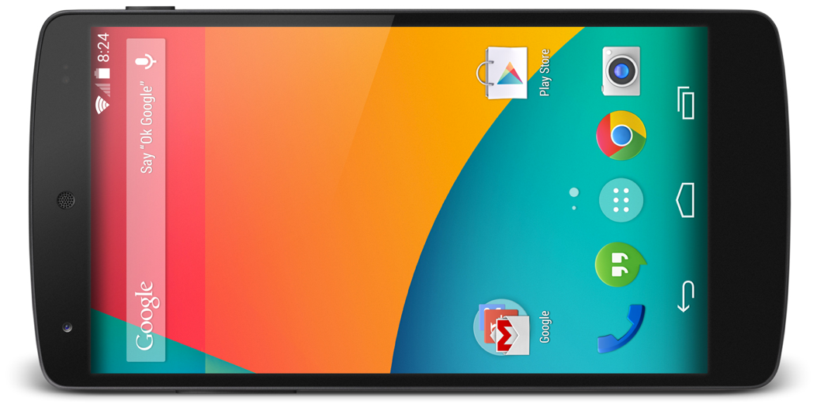

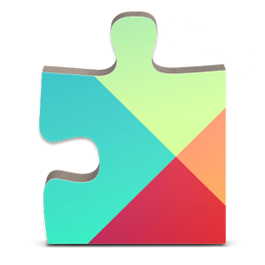
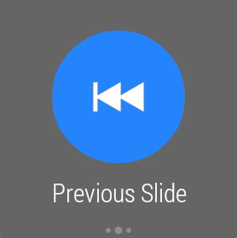
#androidwear
Notes:
The connection between phone and wearable is provided by Google Play Services
The application can send data between the phone and the watch through asynchronous calls through Google Play Services.

Slide 42
GoogleApiClient
mGoogleApiClient = new GoogleApiClient.Builder(context) .addApi(Wearable.API) .addConnectionCallbacks(this) .addOnConnectionFailedListener(this) .build();
#androidwear

Slide 43
Establish Connection
In Activity
@Override protected void onStart() { super.onStart(); mGoogleApiClient.connect(); } @Override protected void onStop() { super.onStop(); mGoogleApiClient.disconnect(); }
#androidwear

Slide 44
Know when two devices are connected
Node
Message
exchange low latency messages
OR
Store data that is shared between phone and wearable
Data
#androidwear
Notes:
There are three types of data exchange
[click] Node API helps you know when two devices are connected, which is when you can exchange data and messages between your phone and the wearable.
[click] Message API allows you to exchange low latency messages. Great for RPCs.
[click] Data API give you the ability to store data that’s shared between the phone and wearable and automatically buffered when the devices are disconnected

Slide 45
Method
PendingResult<GetConnectedNodesResult>
getConnectedNodes(GoogleApiClient);
client);
Listener
public interface NodeListener {
void onPeerConnected(Node peer);
void onPeerDisconnected(Node peer);
}
Node
#androidwear
Notes:
Node API
Can get connected nodes at any time
Or be notified when a peer connects or disconnects

Slide 46
Method
PendingResult<SendMessageResult>
sendMessage(GoogleApiClient client, String nodeId, String action, byte[] data);
Listener
public interface MessageListener {
void onMessageReceived(MessageEvent messageEvent);
}
Message
#androidwear
Notes:
Message API
Send a message and be notified when one is received

Slide 47
Methods
PendingResult<DataItemResult>
putDataItem(GoogleApiClient client, PutDataRequest request);
PendingResult<DataItemResult>
getDataItem(GoogleApiClient client, Uri uri);
Listener
public interface DataListener {
void onDataChanged(DataEventBuffer dataEvents);
}
Data
#androidwear
Notes:
Data API
Put and Get data items
Get notified when data is changed

Slide 48
Service
public class MyListenerService extends WearableListenerService {
...
}
Intent Filter
<service android:name=".MyListenerService" >
<intent-filter>
<action android:name="com.google.android.gms.wearable.BIND_LISTENER" />
</intent-filter>
</service>
#androidwear
Notes:
To receive data, you will need the WearableListenerService
You would usually create instances of this service in both your wearable and handheld apps.
If you don't care about receiving data events in one of these apps, then you don't need to implement this service in that particular app.
Simply create a class that extends WearableListenerService.
Listen for the events that you care about, such as onDataChanged().
Declare an intent filter in your Android manifest to notify the system about your WearableListenerService.
This allows the system to bind your service as needed.

Slide 49
Send data
Custom UI
Voice Actions
#androidwear
Notes:
Now let’s talk about Custom UI

Slide 50
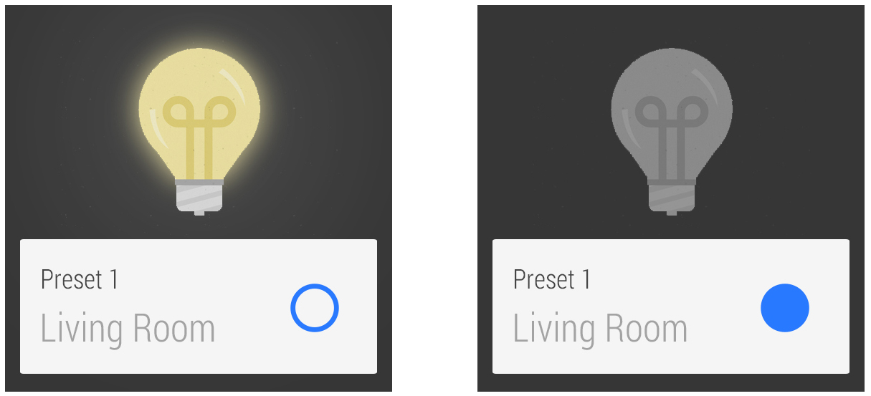
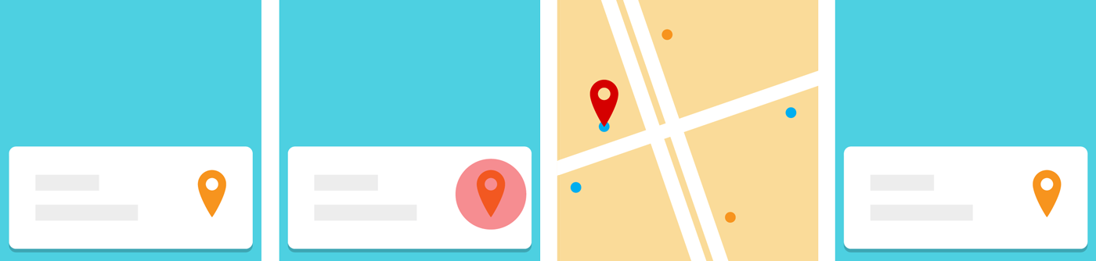
#androidwear
Notes:
Custom notifications
(unofficial) Wearable UI Library

Slide 51
#androidwear
Notes:
In general, you should create notifications on the handheld and let them automatically sync to the wearable. This lets you build your notifications once and have them appear on many types of devices.
If the standard notification styles don't work for you (such as NotificationCompat.BigTextStyle or NotificationCompat.InboxStyle), you can display an activity with a custom layout.
You can only create and issue custom notifications on the wearable, and the system does not sync these notifications to the handheld.

Slide 52
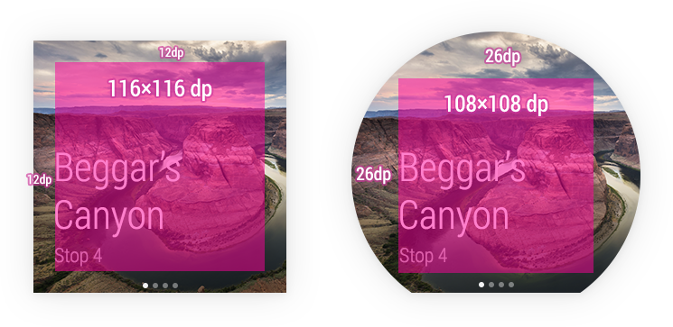
#androidwear
Notes:
There’s an unofficial UI library that helps you build UIs that are designed for wearables.
It’s automatically included when you create your wearable app with the Android Studio Project Wizard.

Slide 53
BoxInsetLayout Card Fragment CircledImageView ConfirmationActivity DismissOverlayView | GridViewPager GridPagerAdapter FragmentGridPagerAdapter WatchViewStub
#androidwear
Notes:
These are some of the major classes you get
A couple of my favorites are…

Slide 54
Send data
Custom UI
Voice Actions
#androidwear
Notes:
And finally, voice actions

Slide 55
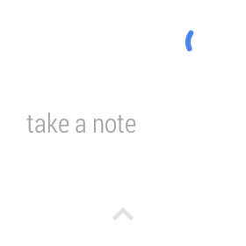
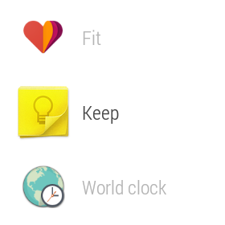
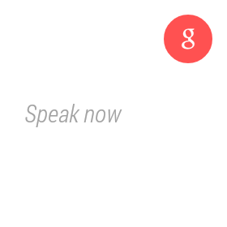
#androidwear
Notes:
[click] System-provided actions are task-based and built into the wear platform and specified with an intent-filter.
[click] App-provided actions are app-based and are declared like a launcher icon.
[click] Free-form Speech Input uses the Speech Recognizer activity to get speech input from the user.

Slide 56
System provided voice action
<activity android:name="MyNoteActivity">
<intent-filter>
<action android:name="android.intent.action.SEND" />
<category android:name="com.google.android.voicesearch.SELF_NOTE" />
</intent-filter>
</activity>
#androidwear
Notes:
System provided voice actions
You filter for them in the activity that you want to start when the voice action is spoken.
Examples include "Take a note" or "Set an alarm".

Slide 57
Call a car/taxi Take a note Set alarm Set timer Start/Stop a bike ride | Start/Stop a run Start/Stop a workout Show heart rate Show step count
#androidwear
Notes:
These are the commands available on Android Wear today

Slide 58
App provided voice action
<activity android:name="StartRunActivity" android:label="MyRunningApp">
<intent-filter>
<action android:name="android.intent.action.MAIN" />
<category android:name="android.intent.category.LAUNCHER" />
</intent-filter>
</activity>
#androidwear
Notes:
App provided voice actions
These voice actions are app-based, and you declare them just like a launcher icon.
Users say "Start " to use these voice actions and an activity that you specify starts.

Slide 59
Speech Recognizer
private void displaySpeechRecognizer() {
Intent intent = new Intent(RecognizerIntent.ACTION_RECOGNIZE_SPEECH);
intent.putExtra(RecognizerIntent.EXTRA_LANGUAGE_MODEL,
RecognizerIntent.LANGUAGE_MODEL_FREE_FORM);
startActivityForResult(intent, SPEECH_REQUEST_CODE);
}
#androidwear
Notes:
Speech recognizer
In addition to using voice actions to launch activities, you can also call the system's built-in Speech Recognizer activity to obtain speech input from users.
This is useful to obtain input from users and then process it, such as doing a search or sending it as a message.

Slide 60
Notifications
Apps
#androidwear

Slide 61
What’s next?
Getting Started with Android Wear
developer.android.com/wear
Design for Android Wear
developer.android.com/design/wear
#androidwear

Slide 62
?
Notes:
Any questions?

Slide 63
Notes:
End

Slide 64
Notes:
Safety

